Slide 1
Bagging, Random Forests, and Boosting
September 2019
A forest doesn't weep over one tree.
- Aleksandr Solzhenitsyn

Slide 2
Reminder/revision: Cross Validation

Slide 3
Live Coding Example k-fold cv
Revising:
k-fold cross validation
k disjoint partitions (no overlap), all observation participate
Repeated random sub-sampling validation
AKA Monte-Carlo cross-validation), validation can be any size, some observations may be skipped
In k-fold CV, how many times would observation i appear in the train set?
/class code/03-cv_example.R

Slide 4
Reminder: Classification and Regression Trees

Slide 5
Building Trees
Classification and Regression Trees is an algorithm used to divide the space into sub-regions. In each region the prediction is given according to the observations which “reside” in the region.
This makes trees a very flexible model.
Trees can be used for either regression or classification.
Caution, flexibility = very high bias = can be easily abused into over-fitting.

Slide 6









Example: How a Tree Classifies
Plane ($p=2$, two classes)
Example tree
Train set error:
Err 46%
Root
$$x_{2}$$
7
6
$$x_{2}≤t_{1}$$
yes
no
$$t_{1}$$
Err 23%
6
2
1
4
$$x_{1}≤t_{2}$$
$$x_{1}≤t_{3}$$
Err 8%
y
n
y
n
Leaf
Leaf
Leaf
Leaf
0
2
6
0
0
4
1
0
$$t_{2}$$
$$t_{3}$$
$$x_{1}$$
Err 0%

Slide 7
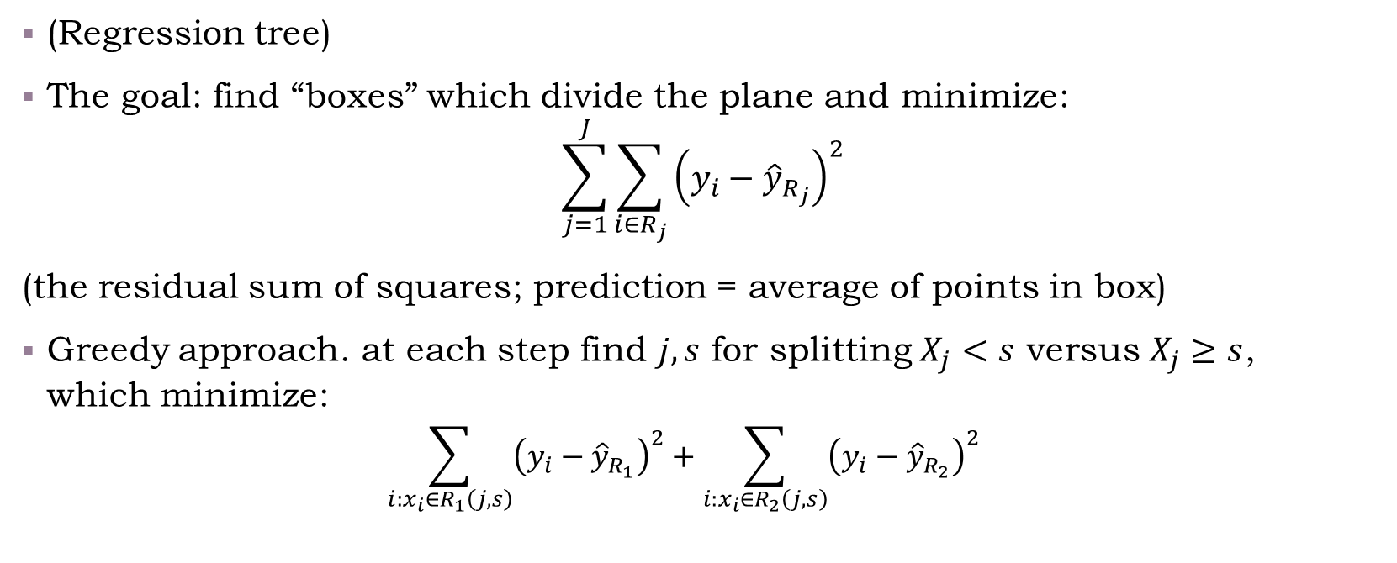
How a Tree is Grown?
(Regression tree)
The goal: find “boxes” which divide the plane and minimize:
$$\sum_{j=1}^{J}{\sum_{i∈R_{j}}{{\left(y_{i}−{\hat{y}}_{R_{j}}\right)}^{2}}}$$
(the residual sum of squares; prediction = average of points in box)
Greedy approach. at each step find $j,s$ for splitting $X_{j}<s$ versus $X_{j}≥s$, which minimize:
$$\sum_{i:x_{i}∈R_{1}\left(j,s\right)}{{\left(y_{i}−{\hat{y}}_{R_{1}}\right)}^{2}}+\sum_{i:x_{i}∈R_{2}\left(j,s\right)}{{\left(y_{i}−{\hat{y}}_{R_{2}}\right)}^{2}}$$
Recursive binary splitting

Slide 8
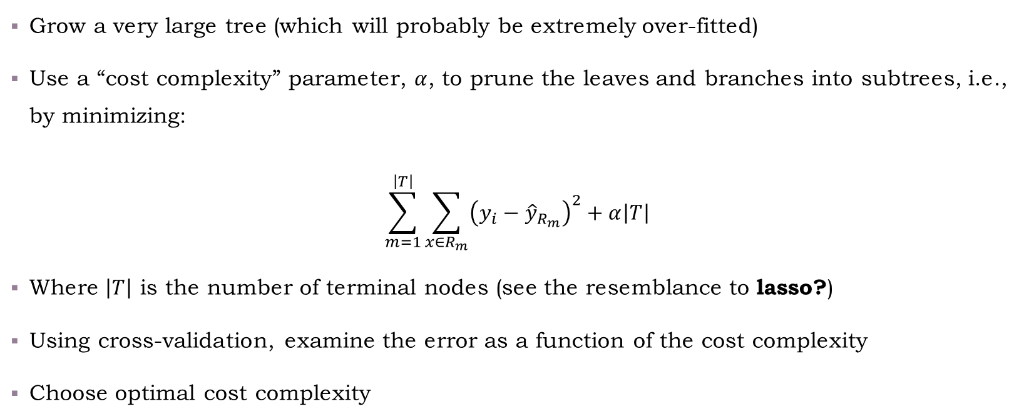
Tree Pruning
Grow a very large tree (which will probably be extremely over-fitted)
Use a “cost complexity” parameter, $α$, to prune the leaves and branches into subtrees, i.e., by minimizing:
$$\sum_{m=1}^{\left|T\right|}{\sum_{x∈R_{m}}{{\left(y_{i}−{\hat{y}}_{R_{m}}\right)}^{2}+α\left|T\right|}}$$
Where $\left|T\right|$ is the number of terminal nodes (see the resemblance to lasso?)
Using cross-validation, examine the error as a function of the cost complexity
Choose optimal cost complexity

Slide 9
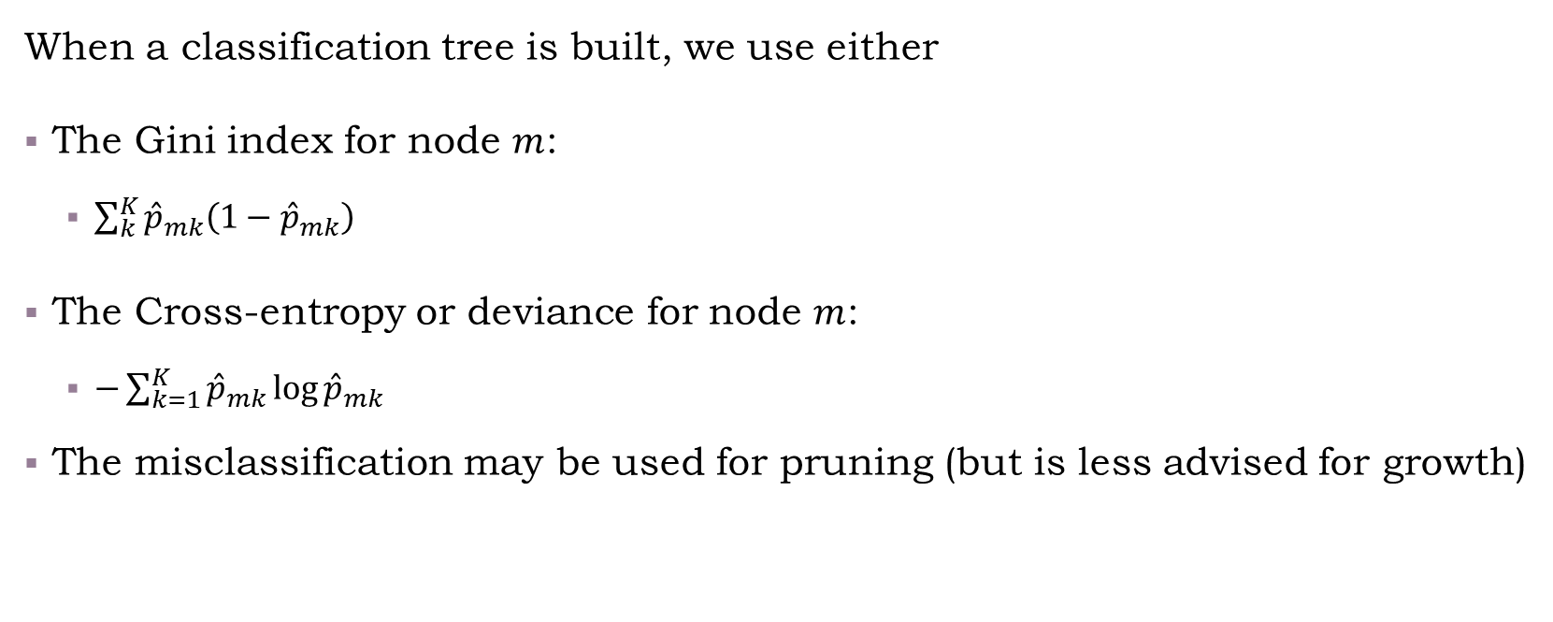
Classification Trees
When a classification tree is built, we use either
The Gini index for node $m$:
$\sum_{k}^{K}{{\hat{p}}_{mk}\left(1−{\hat{p}}_{mk}\right)}$
The Cross-entropy or deviance for node $m$:
$−\sum_{k=1}^{K}{{\hat{p}}_{mk}\log{{\hat{p}}_{mk}}}$
The misclassification may be used for pruning (but is less advised for growth)
Notes:
For details about measures and why misclassification is not that advised, see ESLII pages 309-310.

Slide 10
Contents for today
Unsupervised learning
Supervised learning
Methods
Models
Model evaluation
Linear methods
Classification
Regression
Bootstrap
Boosting
Bagging
randomForest
Trees

Slide 11
Random Forests

Slide 12
Random Forest Algorithm

Slide 13
Random Forest Example

Slide 15
Bagging (“bootstrap aggregation”)

Slide 16
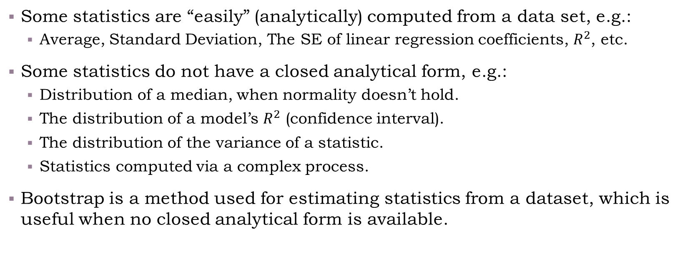
What is Bootstrap?
Some statistics are “easily” (analytically) computed from a data set, e.g.:
Average, Standard Deviation, The SE of linear regression coefficients, $R^{2}$, etc.
Some statistics do not have a closed analytical form, e.g.:
Distribution of a median, when normality doesn’t hold.
The distribution of a model’s $R^{2}$ (confidence interval).
The distribution of the variance of a statistic.
Statistics computed via a complex process.
Bootstrap is a method used for estimating statistics from a dataset, which is useful when no closed analytical form is available.

Slide 17
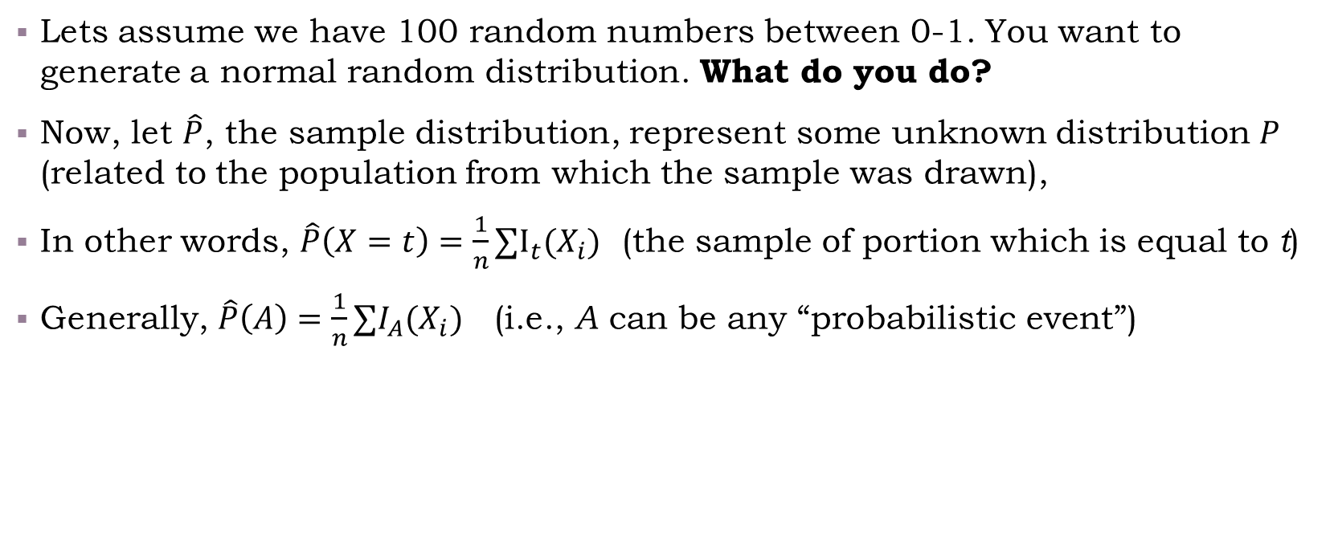
How bootstrap works?
Lets assume we have 100 random numbers between 0-1. You want to generate a normal random distribution. What do you do?
Now, let $\hat{P}$, the sample distribution, represent some unknown distribution $P$ (related to the population from which the sample was drawn),
In other words, $\hat{P}\left(X=t\right)=\frac{1}{n}∑I_{t}(X_{i})$ (the sample of portion which is equal to t)
Generally, $\hat{P}\left(A\right)=\frac{1}{n}∑I_{A}(X_{i})$ (i.e., A can be any “probabilistic event”)

Slide 18


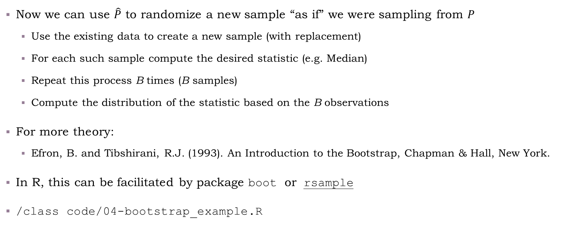
How bootstrap works?
Now we can use $\hat{P}$ to randomize a new sample “as if” we were sampling from $P$
Use the existing data to create a new sample (with replacement)
For each such sample compute the desired statistic (e.g. Median)
Repeat this process B times (B samples)
Compute the distribution of the statistic based on the B observations
For more theory:
Efron, B. and Tibshirani, R.J. (1993). An Introduction to the Bootstrap, Chapman & Hall, New York.
In R, this can be facilitated by package boot or rsample
/class code/04-bootstrap_example.R
Notes:
Add Mentimeter: https://www.mentimeter.com/s/4065641c158611be7b963216aa6d682e/5bf16a135536/edit?
Out of the following, what would require bootstrap? (multiple choice)
The A1c value of a logistic regression
The distribution of an A1c of a logistic regression model
The p-value of logistic regression coefficients
The average of a sample which drawn from an “unknown distribution” (i.e., not normal, exponential, etc.)
The standard deviation of a sample from which was drawn from an “unknown distribution”
A hypothesis test for the monotonicity of a density function
My set is (B; F; and maybe C. Specifically C can also be computed out of the likelihood function using the confint function)

Slide 19
Bagging (Bootstrap Aggregation)
General purpose procedure for reducing the variance of a statistical learning model

Slide 20
How is Bagging Related to Bootstrap?

Slide 21
Bagging Example

Slide 22
Boosting

Slide 23
Boosting Algorithm

Slide 24
Boosting Example

Slide 25
Contents for today
Unsupervised learning
Supervised learning
Methods
Models
Model evaluation
Linear methods
Classification
Regression
Bootstrap
Boosting
Bagging
randomForest
Trees

Slide 26
Bonus: Optimization

